Slide 1
Transmission Modes

Slide 2
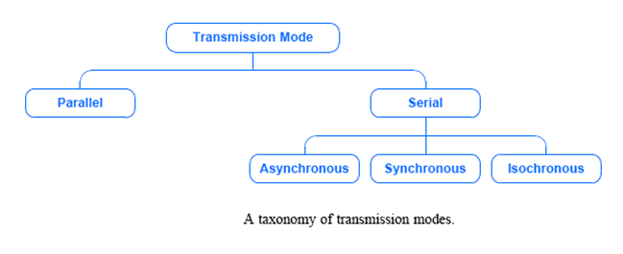
A Taxonomy of Transmission Modes
Defn: A transmission mode is the manner in which data is sent over the underlying medium
Transmission modes can be divided into two fundamental categories:
Serial — one bit is sent at a time
Parallel — multiple bits are sent at the same time

Slide 3
Transmission Order: Bits and Bytes
In serial mode, when sending bits, which bit should be sent across the medium first?
Consider an integer: Should a sender transmit
the Most Significant Bit (MSB) first?
the Least Significant Bit (LSB) first?
Terminology:
little-endian describes a system that sends the LSB first.
big-endian describes a system that sends the MSB first .
Either form can be used, but the sender and receiver must agree.

Slide 4
Transmission Order: Bits and Bytes
Additionally, the order the bytes are sent must be determined.
Data in a computer is divided into bytes, and each byte is further divided into bits (typically 8 bits per byte)
Thus, it is possible to choose a byte order and a bit order independently
For example, Ethernet specifies that data is sent byte big-endian and bit little-endian

Slide 5
Bit-serial Data Transmission
The individual bits are then reassembled at the destination to
compose the message.
In general, one channel will pass only one bit at a time.
Thus, bit-serial transmission is necessary in data
communications if only a single channel is available.
Bit-serial transmission is normally just called serial
transmission and is the chosen communications method in
many computer peripherals.

Slide 6
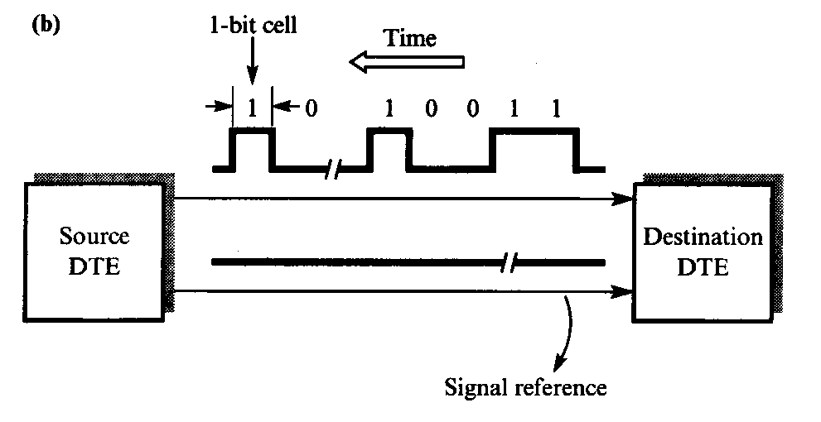
Bit-serial Data Transmission

Slide 7
Timing of Serial Transmission
Serial transmission mechanisms can be divided into three broad categories (depending on how transmissions are spaced in time):
Asynchronous transmission can occur at any time
Synchronous transmission occurs continuously
Isochronous transmission occurs at regular intervals

Slide 8
Serial Transmission
Serial transmission sends one bit at a time.
Most communication systems use serial mode, because:
serial networks can be extended over long distances at less cost
using only one physical wire means that there is never a timing problem caused by one wire being slightly longer than another
Sender and receiver must contain a hardware that converts data from the parallel form used in the device to the serial form used on the wire

Slide 9
Synchronization
Two types of transmission:
Asynchronous
Synchronous
Asynchronous Transmission
In asynchronous transmission, each character is transmitted separately with separate synchronization information.
This type of transmission is often used in situation when characters may be generated at random intervals, such as when a user types at a terminal.
In asynchronous transmission, all of the bits that comprise a character are framed and then sent as a single transmission string.

Slide 10
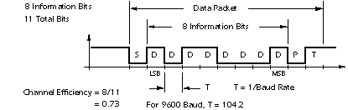
Asynchronous transmission

Slide 11
Asynchronous Transmission
Start and Stop Bit Framing
The clocks of the transmitter and the receiver are not continually synchronized. But the receiver needs to know when the character begins and ends. For this reason, the character's bit string is framed with start and stop bits.
The start bit reset the receiver's clock so that it matches the transmitter's.
The clock only needs to be accurate enough to stay in sync for the next 8 to 11 ticks.
At least one stop bit is added to mark the end of the character and allow recognition of the next start bit.

Slide 12
Synchronous Transmission
In some application it is necessary for large blocks of data, such as the contents of a disk file, to be transmitted. Synchronous transmission is more efficient method of transmitting large block of data. The data are usually buffered and transmitted as an entire message or frame. For this reason, clocks on both sides must maintain synchronization during transmission. This is accomplished in one of two ways:
A separate synchronizing signal, a clock, can be constantly transmitted
Clocking can be included in the data signal

Slide 13
Asynchronous Transmission
Asynchronous transmission allows the physical medium to be idle for an arbitrary amount of time between two transmissions.
It is well-suited to applications that generate data at random time intervals.
For example:
a user typing on a keyboard
a user that clicks on a hyperlink
Asynchronous disadvantage:
While the medium is idle, a receiver cannot know how long the medium will remain idle before more data arrives.
Asynchronous technologies usually require the sender to transmit a few extra bits before each data item:
to inform the receiver that a data transfer is starting
extra bits (preamble or start bits) allow the receiver to synchronize with the incoming signal

Slide 14
Example: RS-232 Asynchronous Character Transmission
Before USB, RS-232-C is the most widely accepted way to transfer characters across copper wires between a computer and a device such as a modem, keyboard, or terminal.
RS-232 defines serial, asynchronous communication.
RS-232 specifies the physical connection as well as the electrical details:
Specified by the EIA
Voltage is +15 or –15 volts
Cable limited to ~50 feet
Latest EIA standard is RS-422 (ITU standard is V.24)
It specifies the transfer of characters (usually 7-bit)
Example use: connection to a keyboard or mouse via the serial port on a PC

Slide 15
Example: RS-232 Asynchronous Character Transmission
For RS-232 to Works asynchronously:
Sender and receiver must agree on
Number of bits per character
Duration of each bit
Receiver
Does not know when a character will arrive
May wait forever
To ensure meaningful exchange send:
Start bit before each character
One or more stop bits after each character
Start bit
Same as 0
Not part of data
Stop bit
Same as 1
Follows data
Figure 5.2 Voltage on a wire as a character is transmitted using RS-232.

Slide 16
Baud Rate, Framing and Errors
The duration of a bit in RS-232 is determined by the baud rate.
Defn: The baud rate of transmission hardware is the number of changes in the signal per second that the hardware generates.
Example: Typical baud rates: 9.6 Kbaud, 14.4 Kbaud and 28.8 Kbaud
For RS-232 (it is a very simple scheme), the baud rate is exactly equal to the number of bits per second.
Example: 28.8 Kbaud = 28.8 kbits per second
To make RS-232 more general, manufacturers design each piece of hardware to operate at a variety of baud rates.
Sender and receiver must agree on the baud rate
Receiver samples the signal to verify agreement
Disagreement results in a framing error

Slide 17
Isochronous Transmission
Isochronous transmission is designed to provide steady bit flow for multimedia applications.
Isochronous networks are designed to accept and send data at a fixed rate, R.
This is ideal when delivering such data at a steady rate is essential (jitter is minimized).
Network interface is set to transmit/receive exactly R bits per second
Example: An isochronous mechanism designed to transfer voice operates at a rate of 64,000 bps:
A sender must generate digitized audio continuously
A receiver must be able to accept and play the stream at 64,000 bps

Slide 18
Byte-serial Data Transmission
Byte-serial transmission conveys eight bits at a time through
eight parallel channels.
Although the raw transfer rate is eight times faster than in bit-
serial transmission, eight channels are needed, and the cost may
be as much as eight times higher to transmit the message.
When distances are short, both techniques may be feasible and
economic to use parallel channels in return for high data rates.
The popular Centronics printer interface is a case where byte-
serial transmission is used.

Slide 19
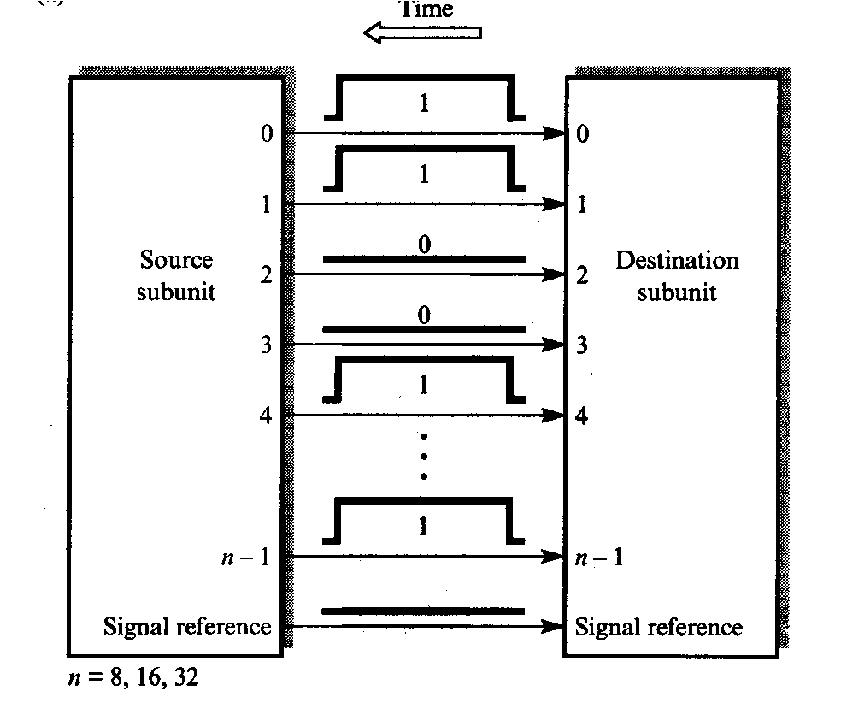
Byte Transmission
As another example, it is common practice to use a 16-bit-wide
data bus to transfer data between a microprocessor and memory
chips.
This provides the equivalent of 16 parallel channels.
On the other hand, when communicating with a timesharing
system over a modem, only a single channel is available, and
bit-serial transmission is required.

Slide 20
Parallel Transmission
Parallel transmission allows transfers of multiple data bits at the same time over separate media.
It is used with a wired medium
The signals on all wires are synchronized so that a bit travels across each of the wires at precisely the same time
The figure omits two important details:
a parallel interface usually contains other wires that allow the sender and receiver to coordinate
to make installation and troubleshooting easy, the wires are placed in a single physical cable
A parallel mode of transmission has two chief advantages:
(1) High speed--it can send N bits at the same time.
(2) It can match the speed of the underlying hardware.

Slide 21
Communication Modes
Three types of communication modes: simple, half-duplex, and full-duplex.
Simplex
One way transmitting, like Radio station. One transmitter, and the rest are receivers.

Slide 22
Hall-Duplex & Full-Duplex
Half-Duplex
Alternating two-way transmit and receive.
When one is transmitting, other is listening,
then one can transmit after a quiet on the channel.
Full-Duplex
Simultaneous transmit and receive at the same time. Of course, one frequency for transmitting, other for receiving.

Slide 23
Simplex, Half-Duplex, and Full-Duplex Transmission
A communications channel can be classified as one of three types:
1. Simplex: A simplex mechanism can only transfer data in a single direction. It is analogous to broadcast radio or television
2. Full-Duplex: Full-duplex allows transmission in two directions simultaneously.
3. Half-Duplex: A
half-duplex mechanism
involves a shared trans-
mission medium. The
shared medium can be
used for communication
in each direction but
the communication
cannot proceed
simultaneously.

